Slide 1



TEAM JOE
TOPIC : ELECTRIC KETTLE
HARSHAVARDHAN
VENIL VENKATA REDDY
VISHAL REDDY
SAI VAMSI
VAMSHI KRISHNA

Slide 2


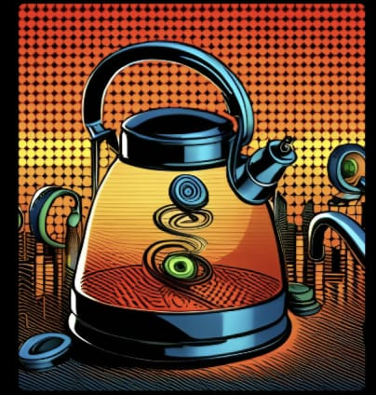




COMPONENTS
THERMOSTAT
HEATING ELEMENT
CORD AND PLUG
SWITCH
WATER LEVEL SENSOR

Slide 3

INTRODUCTION
An electric kettle is a household appliance used for quickly and efficiently boiling water. It operates by using an electric heating element to heat the water inside the kettle, bringing it to a boil. Electric kettles are designed to be portable and convenient, making them a popular choice for boiling water for beverages such as tea, coffee, or hot chocolate.

Slide 4
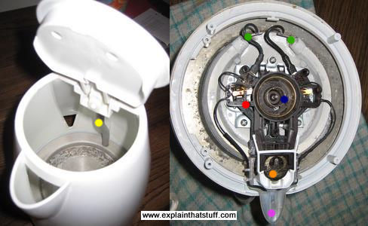
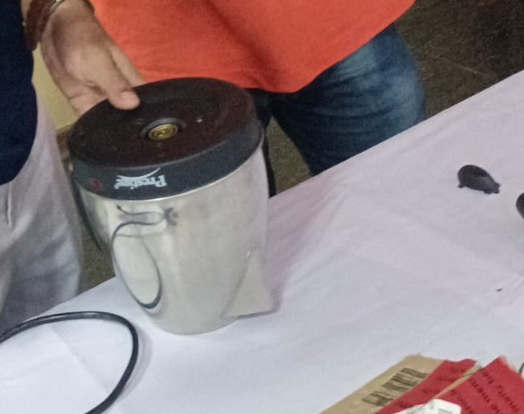
DISMANTLING

Slide 5
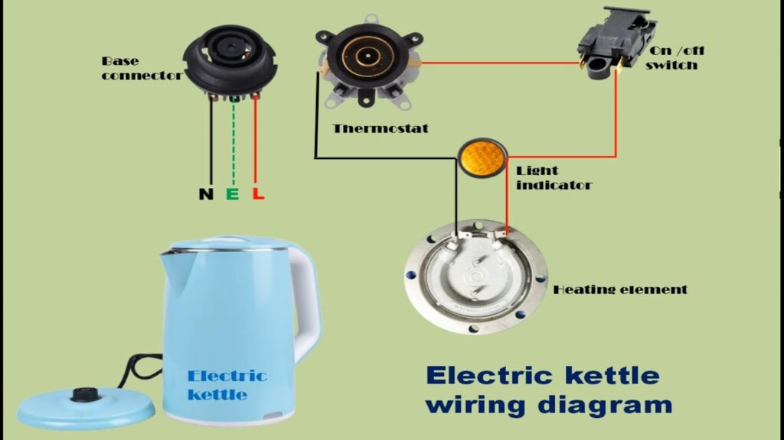
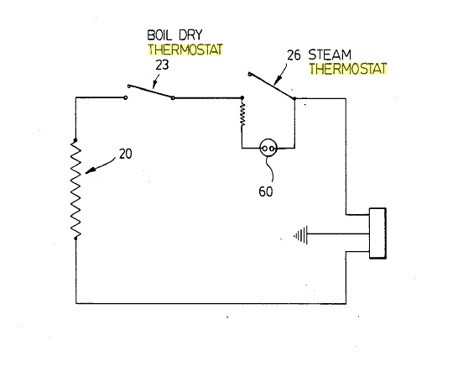
CIRCUIT DESIGN

Slide 6
Here are some key features and aspects of electric kettles:
Design: Electric kettles typically consist of a container with a handle, a lid, and a heating element at the base. The container is usually made of stainless steel, glass, or plastic. The design may also include water level indicators and temperature controls.
Heating element: The heating element is the component responsible for heating the water. It is usually made of a metal, such as stainless steel or copper, which has a high resistance to electric current. When the kettle is plugged into an electrical outlet and switched on, the heating element begins to heat up rapidly, transferring heat to the water.
Automatic shut-off: Most electric kettles are equipped with an automatic shut-off feature. Once the water reaches its boiling point, the kettle automatically turns off, ensuring safety and energy efficiency. Some models also have a boil-dry protection feature that turns off the kettle if it detects there is no water inside, preventing damage to the appliance.
Cordless and corded options: Electric kettles are available in both cordless and corded models. Cordless kettles have a separate base that connects to the power source, allowing the kettle to be easily lifted and moved around. Corded kettles have a built-in cord that plugs directly into the electrical outlet.
Temperature control: Certain electric kettles offer temperature control options, allowing you to select the desired temperature for different beverages or food preparations. This feature is particularly useful for making specialty teas that require specific water temperatures.

Slide 7
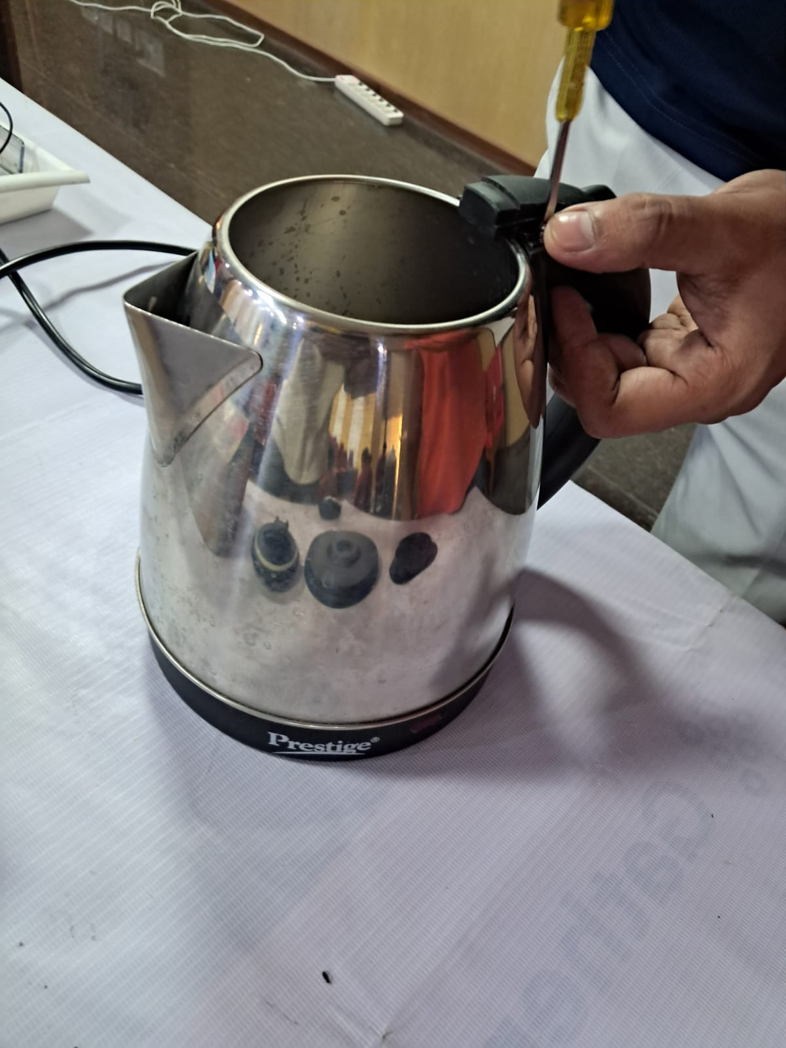
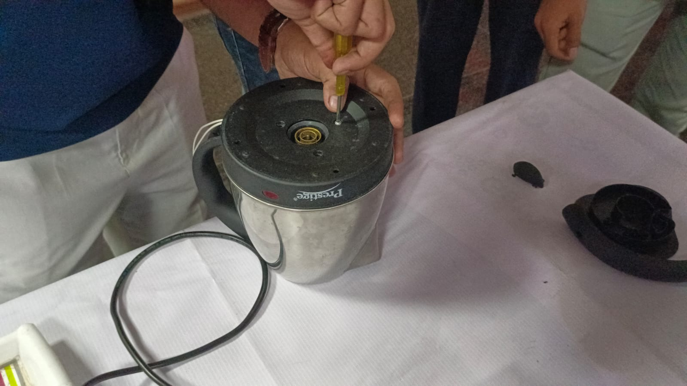
RE-ASSEMBLING

Slide 8

THANK YOU

